Slide 1
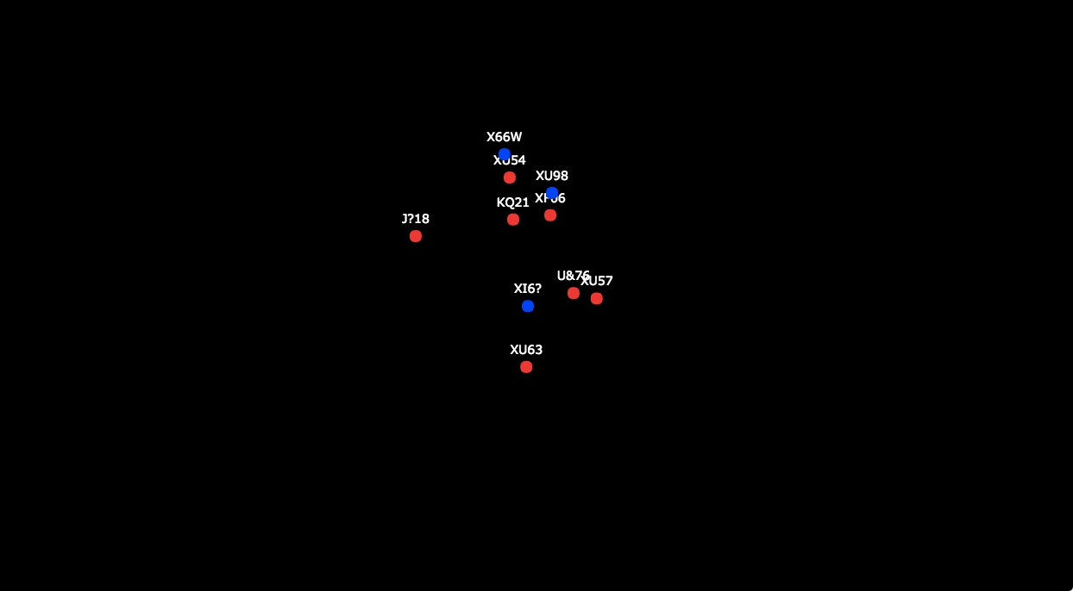

Group differences in cognitive workload
Reilly Innes, Zachary Howard, Caroline Kuhne, Ami Eidels & Scott Brown
A project in collaboration with the royal Australian air force

Slide 2
The data presented here is highly…

Slide 3
Mission Report (Brief)
Last decade….
(2017)
Contact was made with RAAF Squadron 4 (Williamtown RAAF base)
A special forces division
Combat Controller Candidate Selection
They needed our help… (yes, the Government needed our help)

Slide 4

Combat Controller
Role
Track enemies
Receive lots of info
Map movements
Launch attacks
Selection Methods
Cognitive testing
Spatial ability, memory span, speech intelligibility, working memory, attentional control and more
Physical testing
Range of intense fitness tests
Notes:
CC are essentially a heavy metal ATC. Theyre deployed on the ground and required to track allies and enemies on the ground and in the air. They receive information from multiple sources, then they have to manually map this information and translate it to make movements and launch attacks and airstrikes.
Their current selection measures include a battery of cognitive tasks and a range of physical tests. What they wanted to compliment these was a combat controller relevant task. A where good candidates should excel. task they should be really good at.

Slide 5
Step 1: Propose an Ecologically Valid Task
Measure workload differences
In an applicable task
Detection Response Task as the measure
Multiple Object Tracking task as main task
Workload = difficulty = number of tracked targets

Slide 6
DRT = Detection Response Task
Measures Residual Capacity
Short salient stimulus -> light or vibration, lasting for 1 second
Detect and Respond (quickly)
Every 3-5 seconds
Fast responses = Low workload Slow responses = High workload

Slide 7
DRT
The DRT measures leftover resources from dual tasking
Fast responses = More Resources Slow responses = Less Resources
Same task & same performance
–> fast responses = more available resources (i.e. more starting capacity?)
Could also be explained by;
More efficient allocation of resources (optimal tradeoff)
Decision bias (threshold)
Faster processing (processing speed)

Slide 8
MOT
The next slide will show a demonstration of the MOT task
Track the blue dot
It will only stay blue for a short amount of time
You can see the ecological validity

Slide 9

Basic Experiment

Slide 10

Basic Experiment (Hard)

Slide 11
MOT-DRT Combined
The next slide adds in the DRT
DRT = red frame
Keep tracking the blue dots

Slide 12
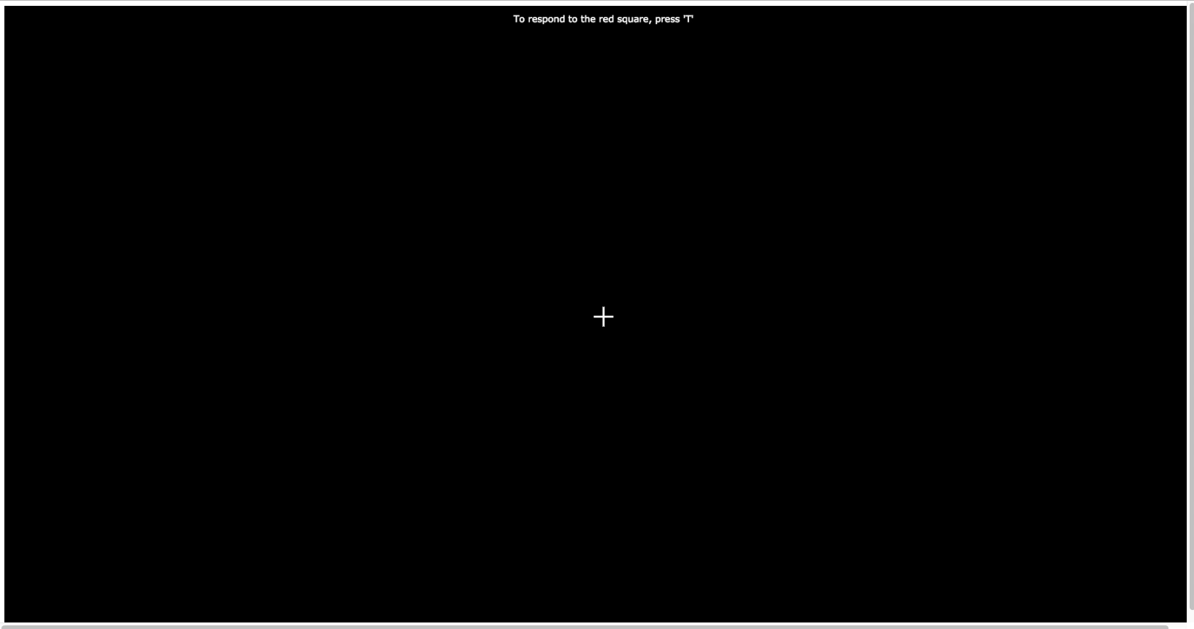
MOT-DRT combined

Slide 13
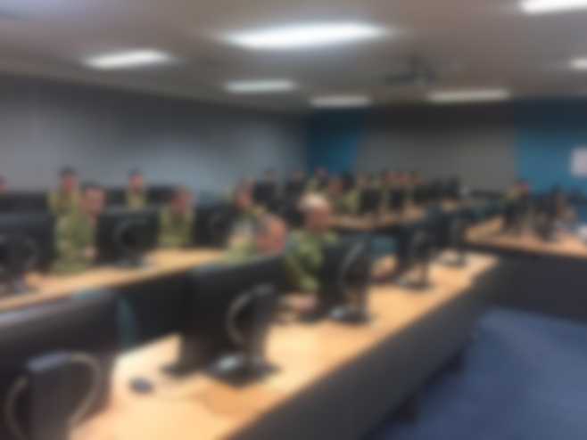
Combat Controller Task
Conditions = 0, 1 or 4 dots to track
0 = no workload – only DRT responses
1 = low workload
4 – high workload
53 Combat Controller trainees tested over three cohorts
30 Trials of each condition
Compared to student group – who were tested online (N = 64) and in lab (N=28)

Slide 14
Groups Outcomes
CC
CC
Student
Student
Response Time
Accuracy
DRT - RT
MOT - Accuracy
Notes:
Make sure you explain slower vs higher

Slide 15
What they care about
They want a way to discriminate between individuals
They don’t want to know that they’re better than students
Step 2: Give them the microfilm (data)

Slide 16
Combat Controller Outcomes
Better Performers
Response Times
Notes:
Add colour graph with students

Slide 17
Combat Controller Outcomes
Better Performance
Darker = Faster DRT
i.e. less loaded
Better Performance

Slide 18
Where to?
Compare selected vs others?
Link to other metrics?
Compare to qualified personnel?

Slide 19
Where to?
Compare selected vs others?
Link to other metrics?
Compare to qualified personnel?

Slide 20
Where to?
Compare selected vs others?
Link to other metrics?
Compare to qualified personnel?

Slide 21
Where to?
Compare selected vs others?
Link to other metrics?
Compare to qualified personnel?

Slide 22
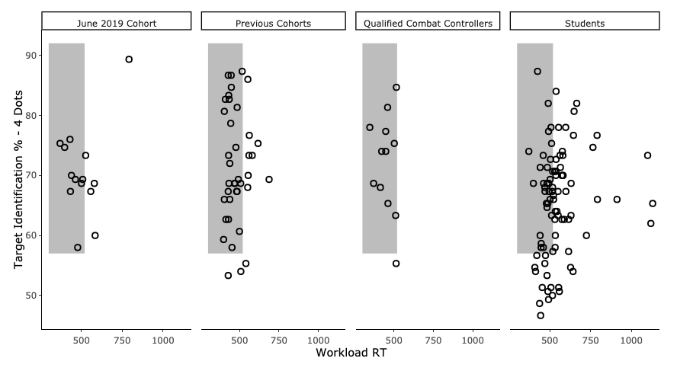
Combat Controller Outcomes

Slide 23
What does this mean?
DRT is effective in showing workload differences between subjects
Group differences exist between students and highly skilled combat controllers
Get military people to do your studies
Future: joint modelling

Slide 24
Cheers

Slide 25

The Model (very quickly)
An LBA
With varying threshold and drift
And a threshold bias because responding wasn’t even

Slide 26
Modelling

Slide 27
Modelling

Slide 28
Modelling

